Slide 1
Big Three LLC
Tehran, Iran
May 6-8, 2024

Slide 2
ABOUT THE COMPANY
Big Three LLC is a software development company with more than eight years of experience in the market. It has an annual turnover of approximately $10 million and a portfolio that includes nearly 100 completed government contracts and numerous contracts with major Russian companies.
The main focus of Big Three's work is on digitalizing processes in the fields of ecology (waste management and environmental monitoring) and implementing digital projects for government agencies. It provides a full range of services, including business process analysis, consulting, and full-cycle software development.
Today, the company is well-established and ready to export its solutions to other markets.

Slide 3
OUR COMPANY
We create efficient software solutions. From project planning to deployment and installation on a server, our company strives to achieve one goal - to develop a groundbreaking system that could become a new industry standard.
The company employs approximately 300 specialists, ranging from software developers and engineers to analysts. Each year, we win numerous prestigious national awards. The government of the Russian Federation acknowledges our efforts.
More than 8 years of experience in IT
Qualified and scalable project teams ready to meet your needs
More than 100 realized projects in the portfolio: from mobile apps and micro-programms to high-load enterprise platforms
15 registered objects of intellectual rights
Over 1 million users work in our systems

Slide 4
COMPANY SERVICES
1
4
DIGITALIZATION OF BUSINESS PROCESSES
OPTIMIZATION AND PLANNING SYSTEMS
2
5
CONSULTING SERVICES AND BUSINESS ANALYSIS
ONBOARDING AND TRAINING
3
CONFIGURING AND SUPPLYING OF PLATFORM SOLUTIONS

Slide 5
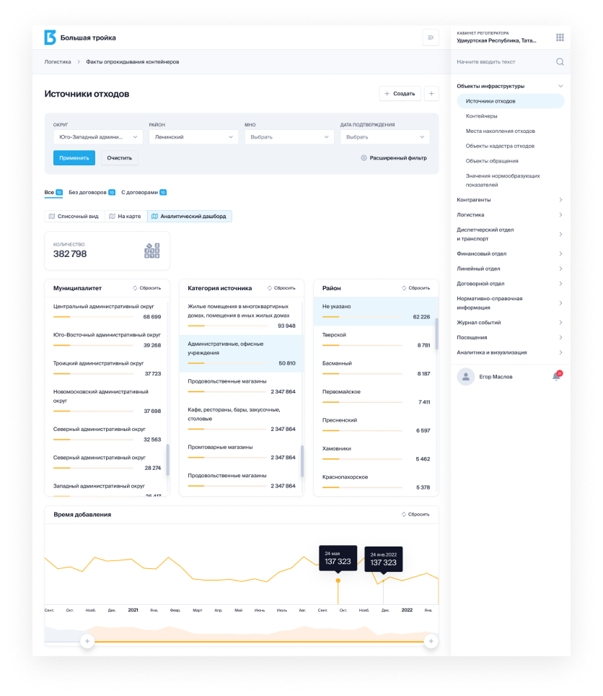
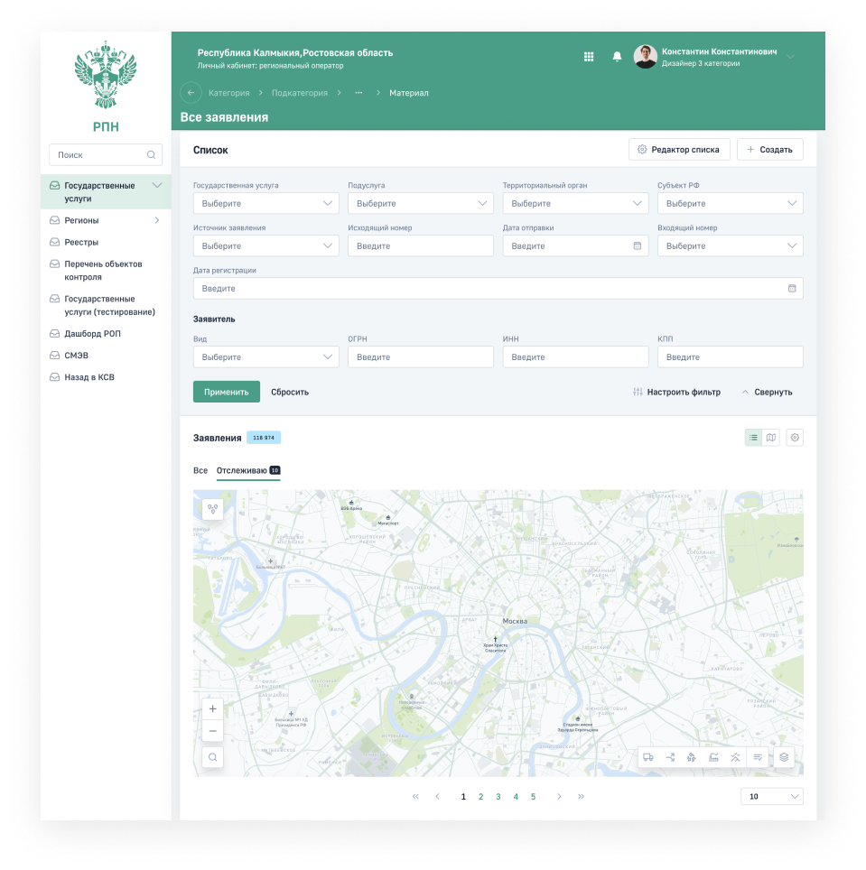
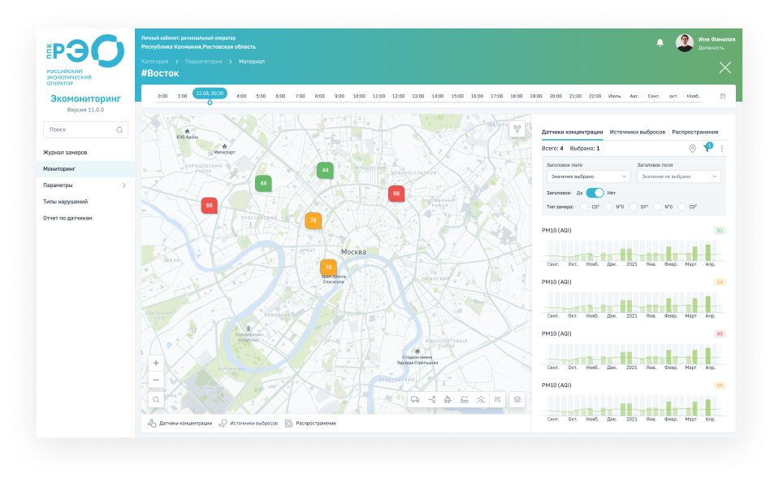
COMPANY PRODUCTS
“Platform”
The “Platform” is a multi-faceted solution for creating various high load web-applications

Slide 6
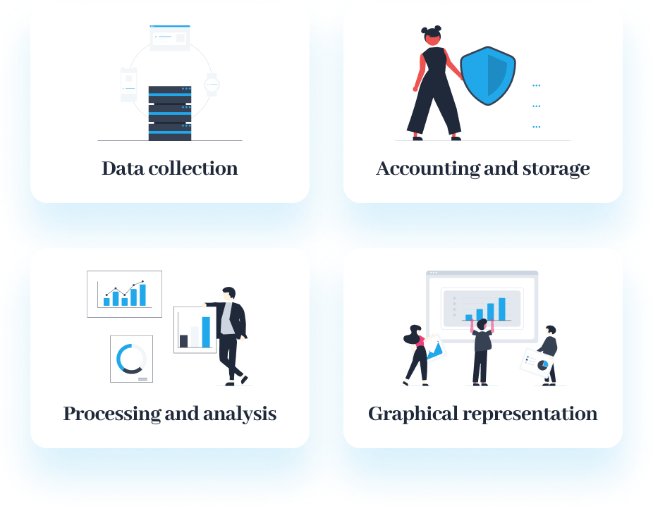
COMPANY PRODUCTS
“Platform” automates 4 areas of work with information
This allows us to develop comprehensive solutions that meet the needs of the information systems market. In each area, the platform provides a set of basic modules (see next slides) that cover up to 80-90% of user needs, as well as the ability to add new modules that are specific to a particular industry or product.

Slide 7
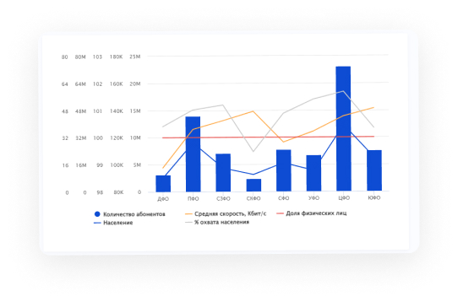
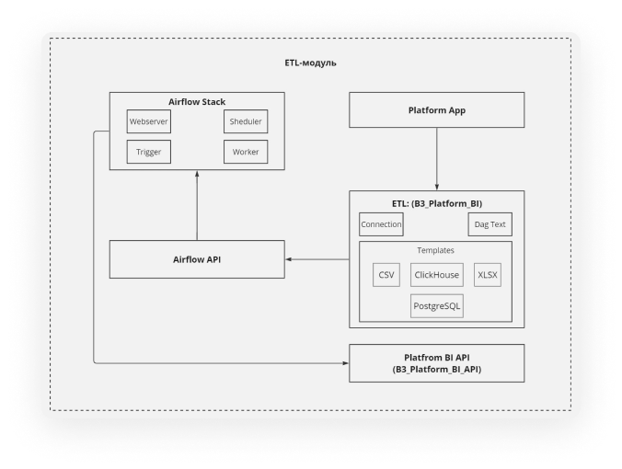
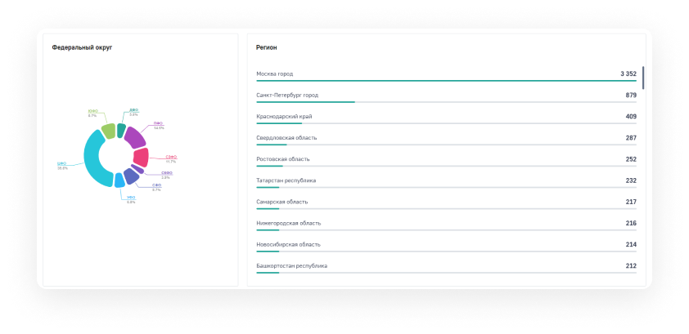
COMPANY PRODUCTS
BI-module
The module allows you to create analytical summaries, dashboards, and widgets for registries on the platform in a matter of seconds. In addition, it is able to connect to third-party databases.
It includes:
Dashboards designer;
Reports designer;
ETL operations;
Geospatial analysis

Slide 8
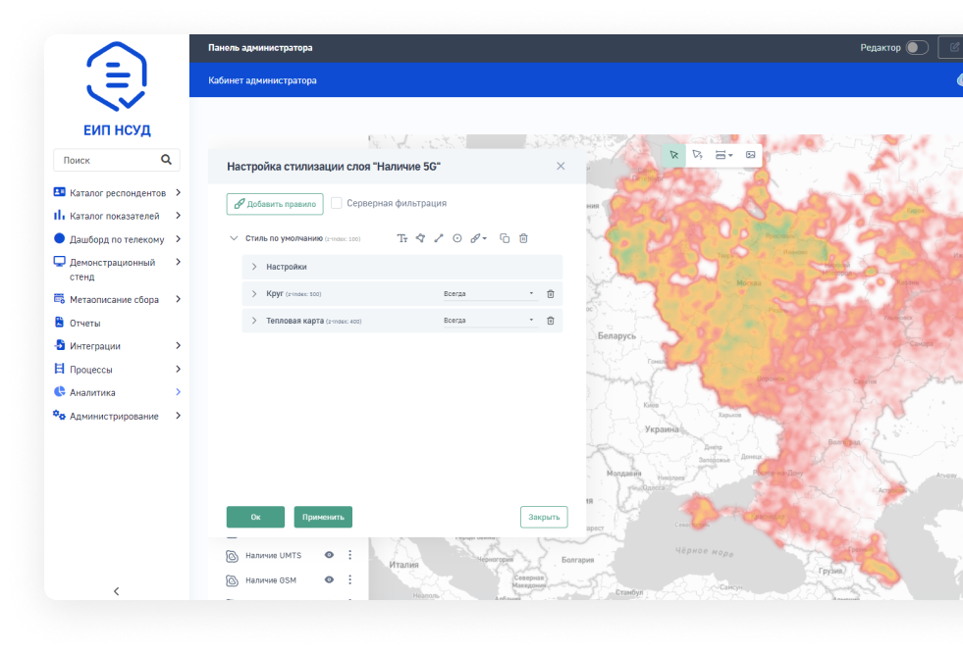
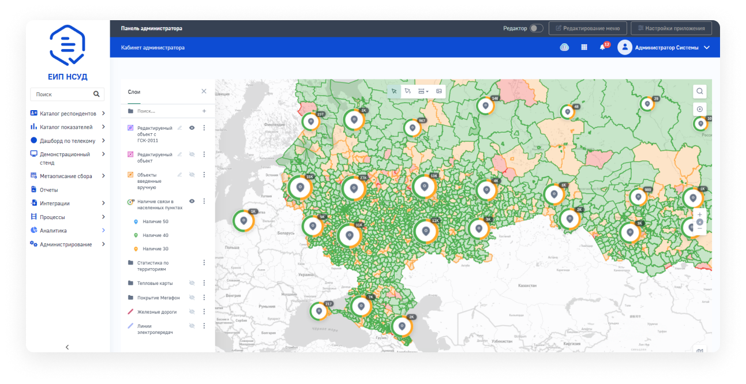
COMPANY PRODUCTS
GIS-module
The module allows you to work with maps and spatial information both for representing your data and analysis or for a work with spatial layers.
It includes:
Heat maps, cover maps;
Analytical functions;
ETL operations on spatial data;
3D-maps

Slide 9
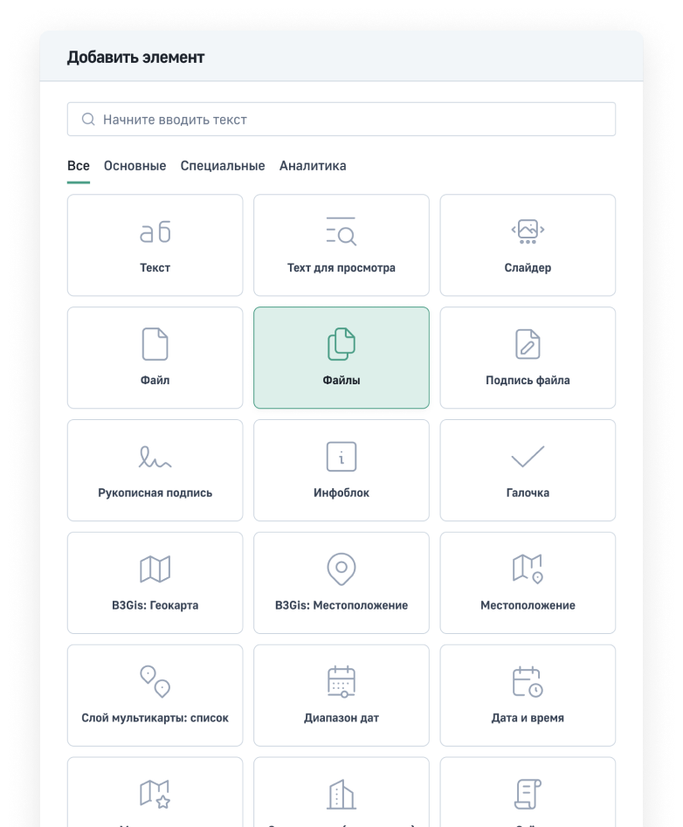
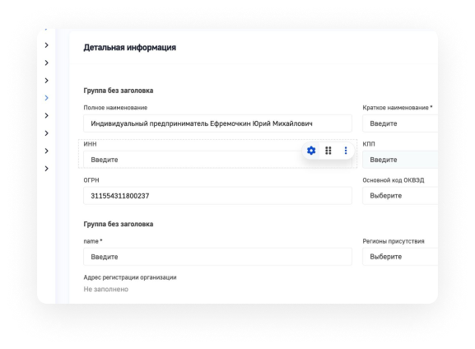
COMPANY PRODUCTS
CMS-module
The module allows creation of personal accounts and websites without coding. Allows you to quickly create an interface for viewing, editing, and analyzing records from any existing database. Supports the creation and editing of data structures through a special interface.
It includes:
Creation of interactive interface forms;
Automatic creation of data structures;
More than 60 ready-to-use templates;
Support of formulas, data validation

Slide 10
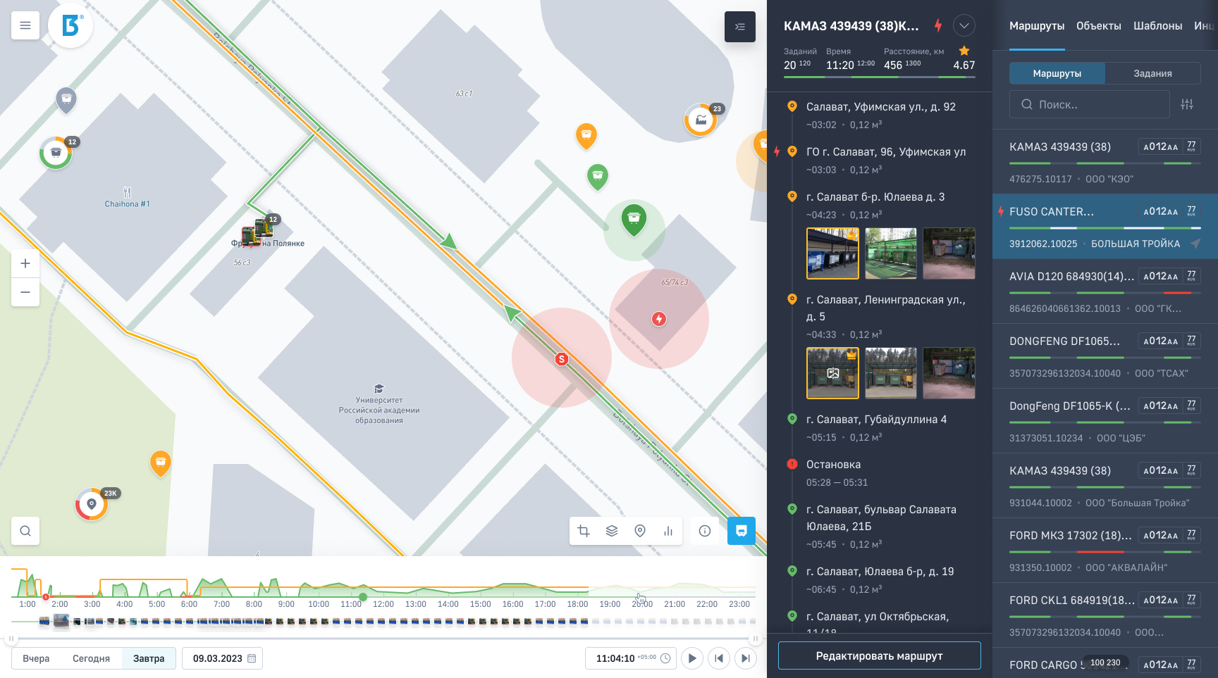
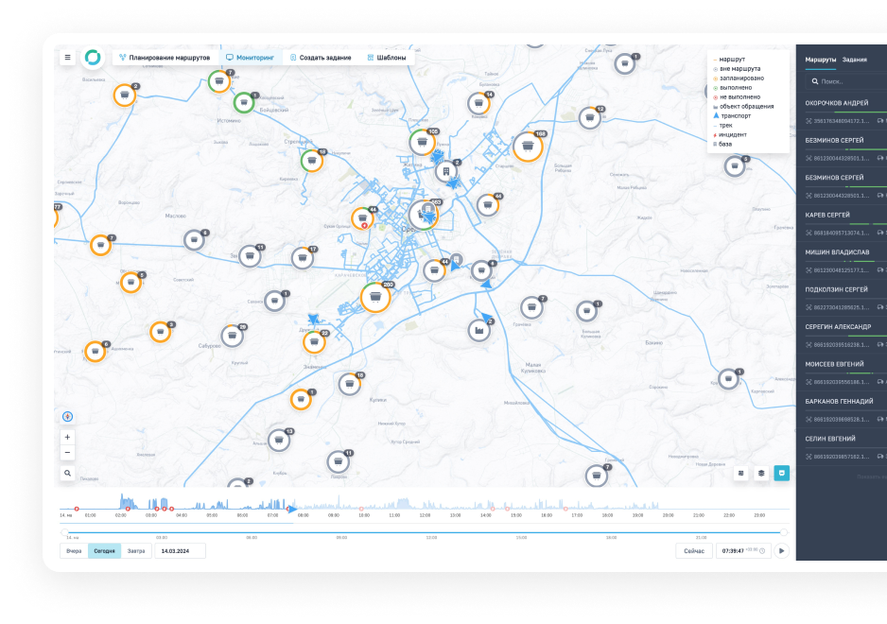
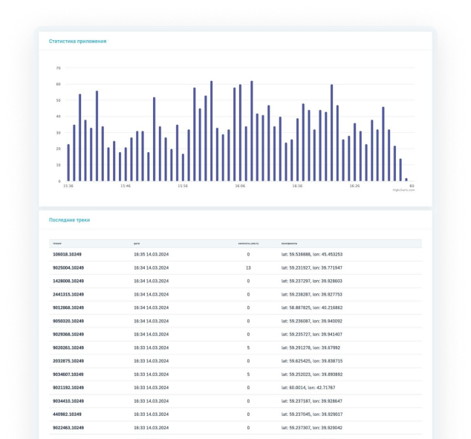
COMPANY PRODUCTS
Telemetry an IoT modules
An extensible set of protocols for receiving data over low-level transmission protocols.
It includes:
Handling up to 500 000 requests per sec;
Support of Big Data receiving – billions of records;
Filters and validation of incoming data;
Authorization of devices;
Processing of income data;
Multiple simultaneous transmissions

Slide 11
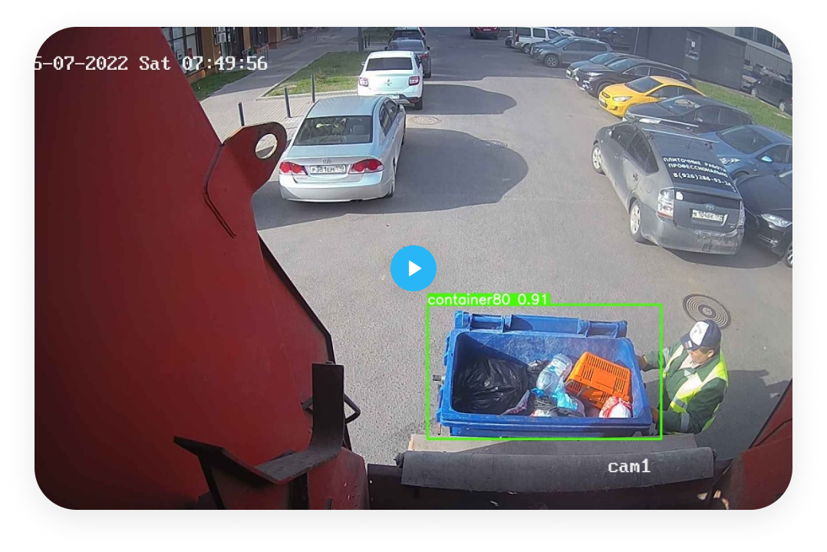
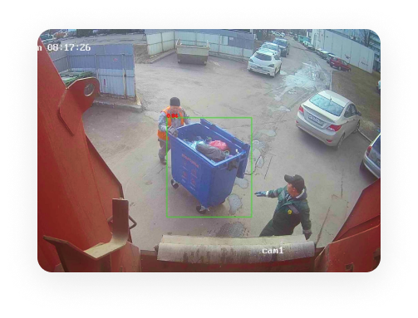
COMPANY PRODUCTS
Monitoring of video and photos
Video streaming from stationary or mobile objects, receiving and processing of photos and videos in the background.
It includes:
Preprocessing of streaming data;
Rapid analysis of metadata;
Automatized correction and transformation of incoming photos;
Machine vision - images recognition based on a trained neural net.

Slide 12
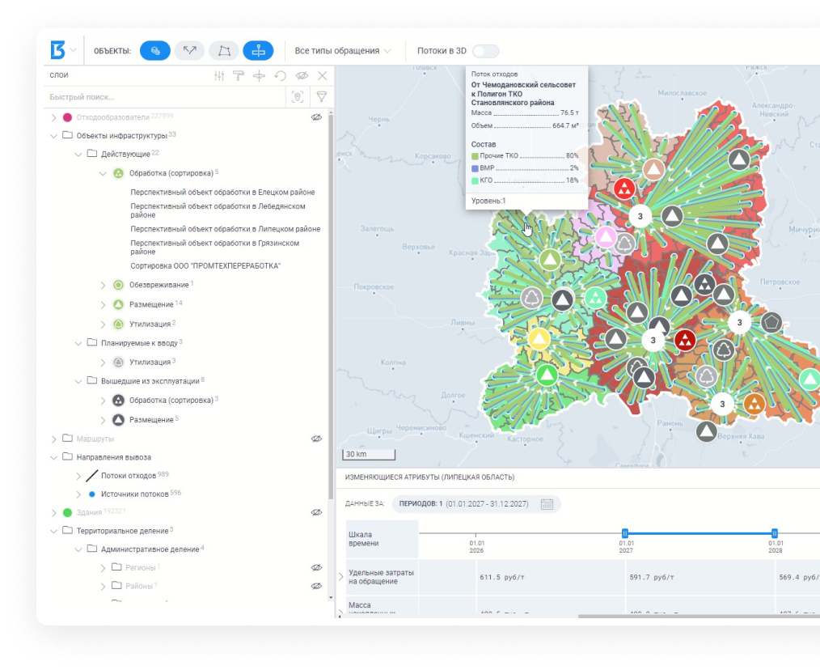
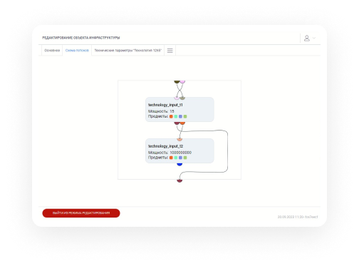
COMPANY PRODUCTS
Algorithms module
Algorithms for solving optimal solutions searching tasks
It includes:
Multiple route planning;
Solving linear programming problems;
“Last mile” task solver.

Slide 13
OUR PARTNERS
“Rostelecom” – the biggest IT
and telecom company
“Selectel” – one of the biggest
data center providers
“SBER” – Russian top-bank
“Agency for Strategic Initiatives” –
the government NCO
“Russian Environmental Operator” –
public law municipal waste management company
“MIPT” – Moscow Institute
of Physics and Technology

Slide 14
OUR MAIN CLIENTS
“Rosatom” – Russian State Atomic
Energy Corporation
Federal Service for Supervision
of Natural Resources
“Ecotechprom” – the main Moscow
waste management company
The government of Moscow region
The government of Moscow
+ More than 100 regional subjects
of Russia and private companies

Slide 15
PROJECT GEOGRAPHY
Russian Federation
Dubai, UAE (in process)
Astana, Kazakhstan (in process)

Slide 16
CONTACTS
www.big3.ru
info@big3.ru
+7 495 109 03 05

