Slide 1

PF LOGOS, LLC
Tehran, Iran
May 6-8, 2024

Slide 2


ABOUT THE COMPANY
PF Logos LLC is a world leader in the development and manufacture of equipment for training and testing the driving skills of drivers of public and special transport.
PF Logos LLC is a specialized enterprise focused on the development and production of modern training simulators for different vehicles and special equipment, subway, as well as systems for objective control of drivers' actions during exams in the process of obtaining driver's licenses.

Slide 3
OUR COMPANY
Full-cycle enterprise - our own production and software development teams - allows us to implement the most complex requests of our customers quickly and considering local legal requirements.
The installation and use of our vehicle simulators allows you to save up to 30% on the cost of maintenance, practical movement on roads/routes, insurance, reduce the accident rate and increase the comfort of passengers.
More than 30 years of experience in Simulator’s development
Providing full technical support in 5 Countries
More than 200 realized projects since 2020
An extensive database of simulators already installed and operating daily in more than 20 countries of the world

Slide 4
COMPANY SERVICES
1
2
DEVELOPMENT
MANUFACTURING
3
4
COMISSIONING
TECHNICAL SUPPORT

Slide 5
COMPANY SIMULATOR TYPES
1
2
DRIVING GROUNDS AUTOMATION SYSTEM (SMART YARD)
PUBLIC TRANSPORT DRIVING SIMULATORS
3
4
METRO ROLLING STOCK DRIVER SIMULATORS
DUAL-PURPOSE SIMULATORS

Slide 6
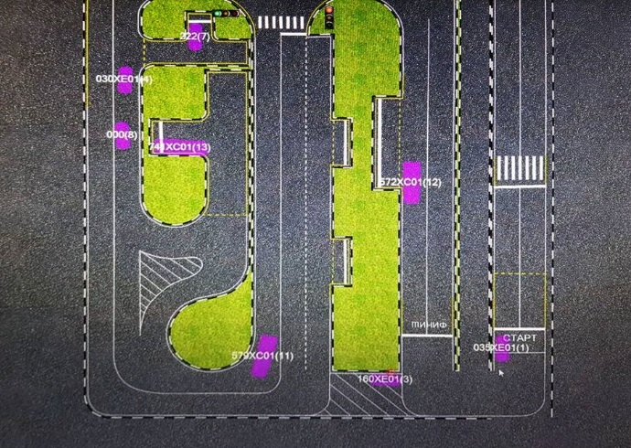
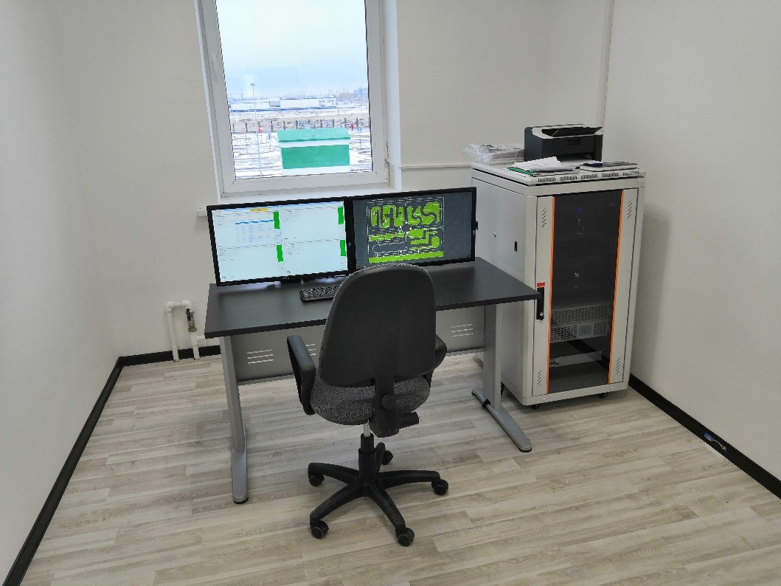

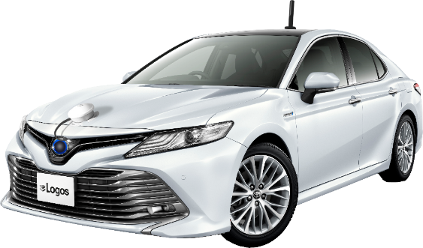
SMART YARD PRODUCT
The Smart Yard includes a complex of special hardware and software that are intended for training and examining for qualification with use of an automated system for monitoring and driving skills evaluating of candidates for drivers.

Slide 7
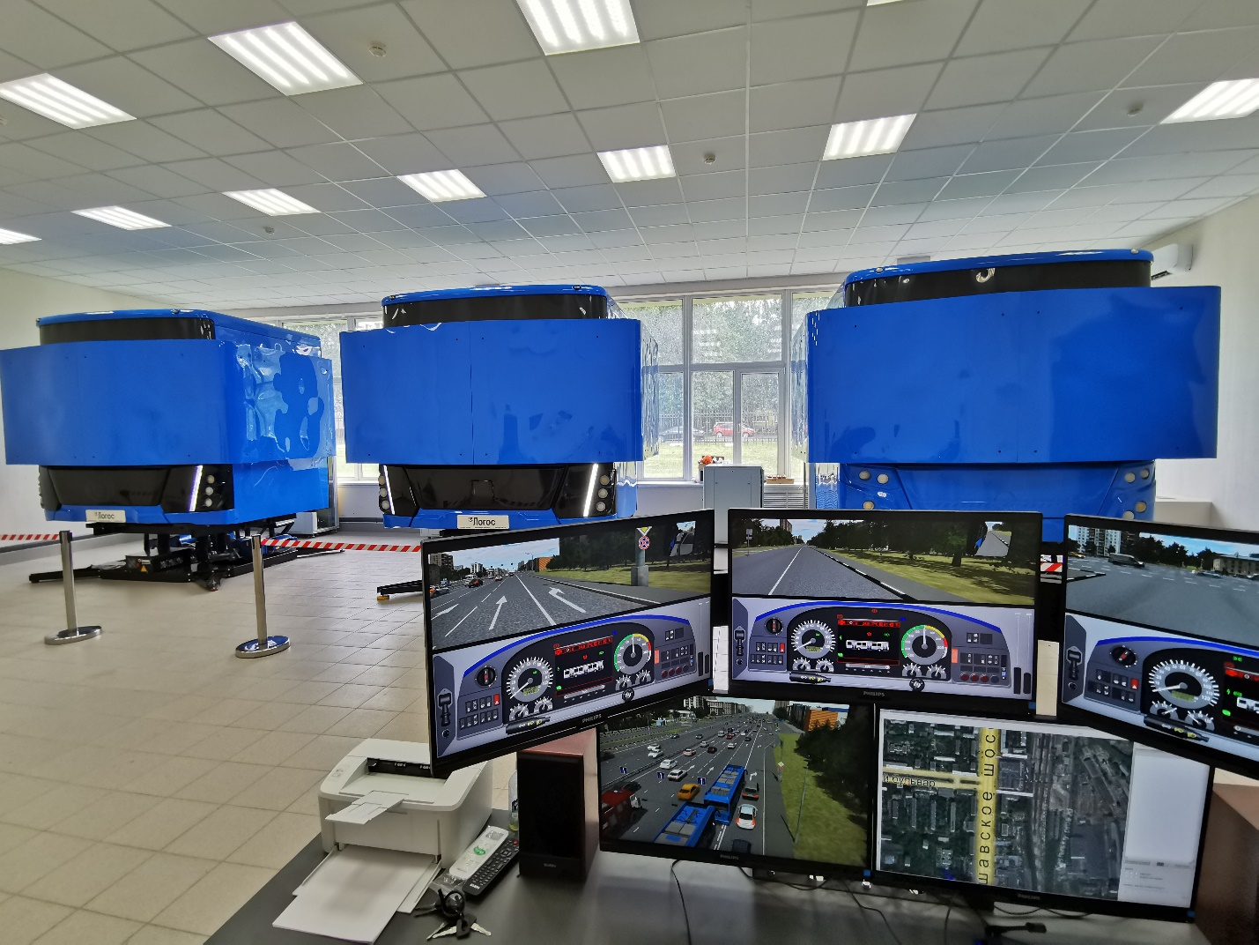
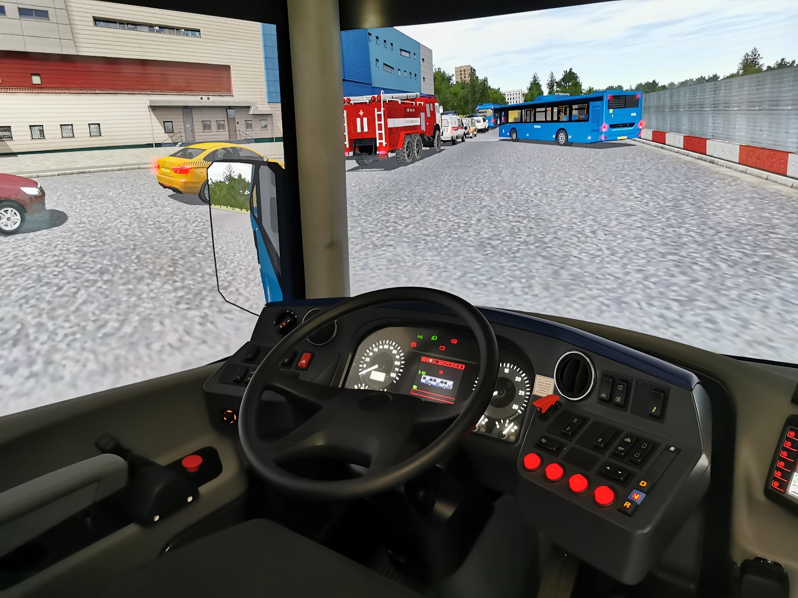
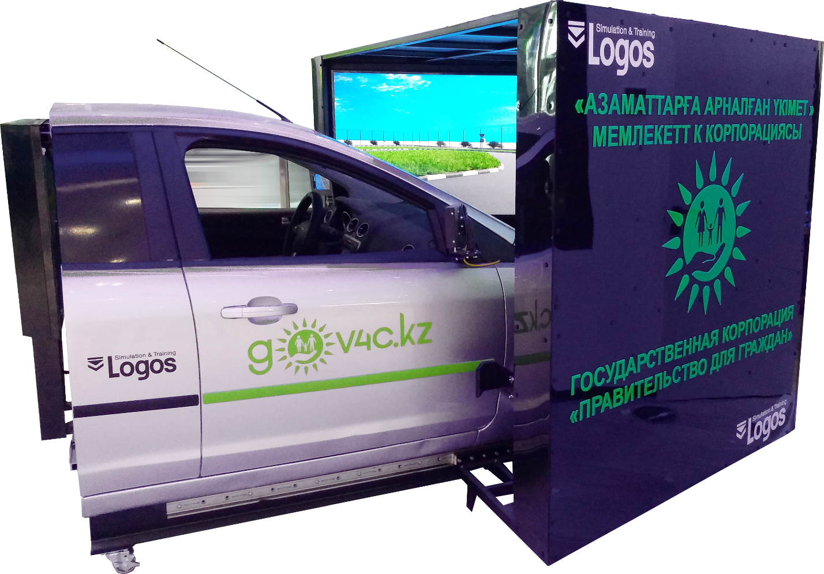
SIMULATOR PRODUCTS
Simulators are designed to check basic driving skills and improvement of vehicle control techniques in various landscape, road and weather conditions, in a simulated urban road environment.
Computer visualization system in virtual three-dimensional space and use of real driver's cabin installed on three-degree or six-degree dynamic platform provide process of training without consumption of fuel, lubricants and motor resource.

Slide 8
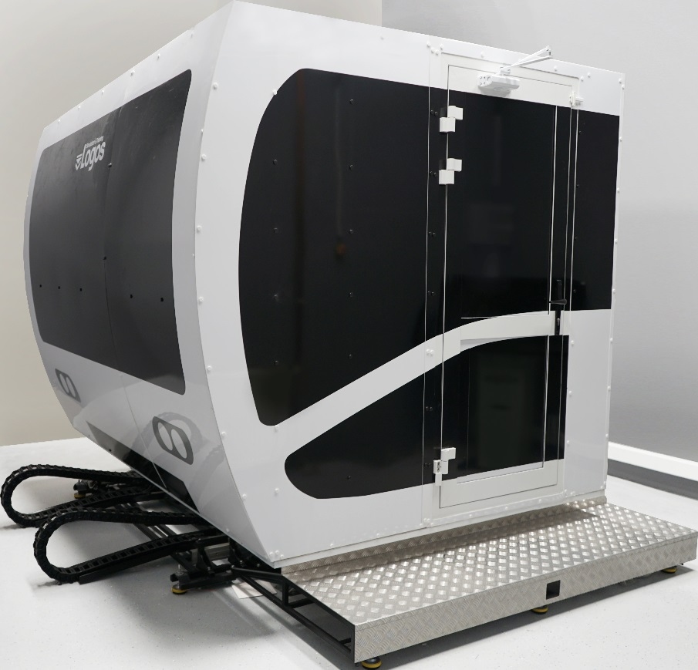
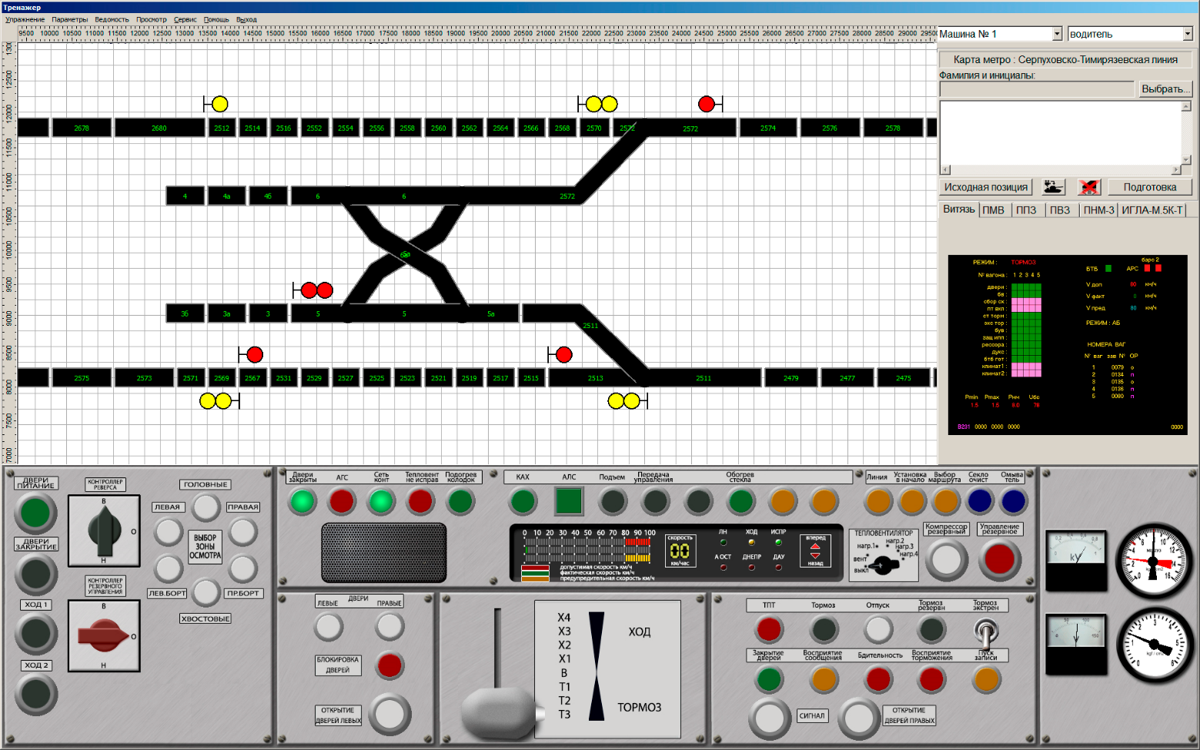
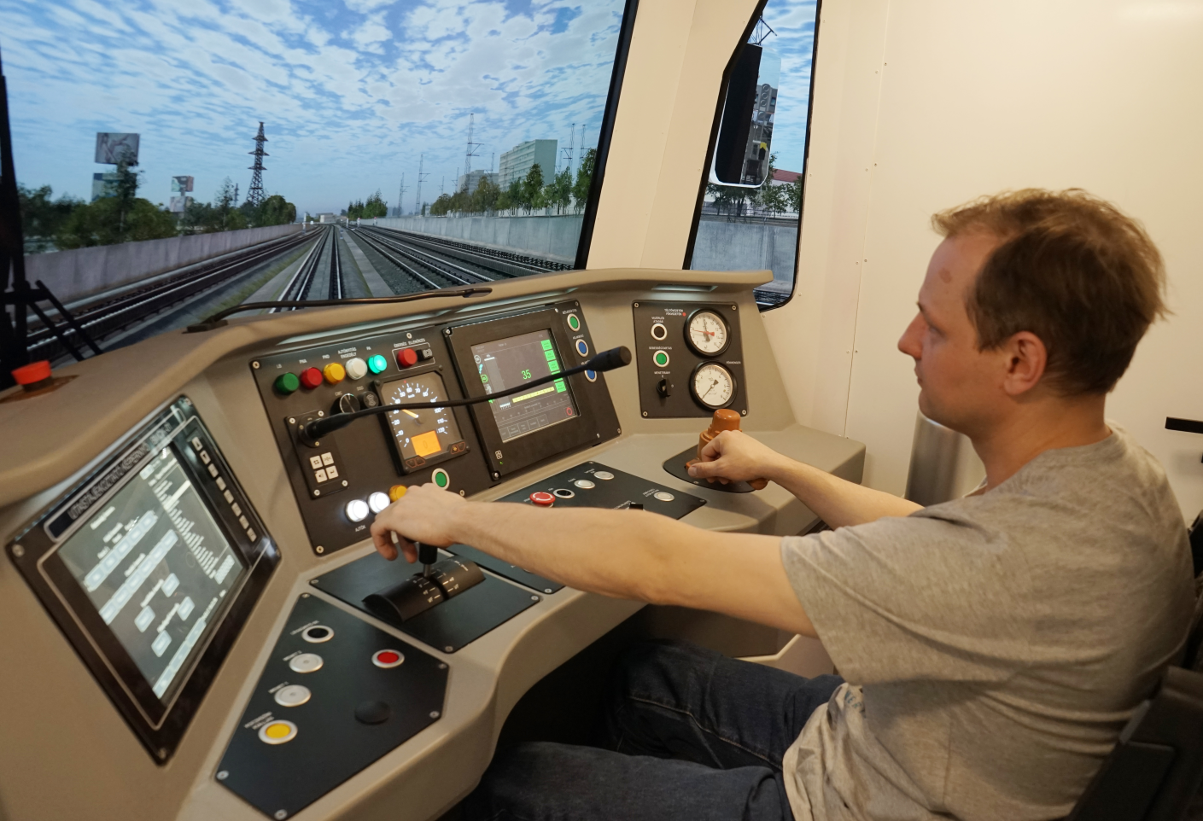
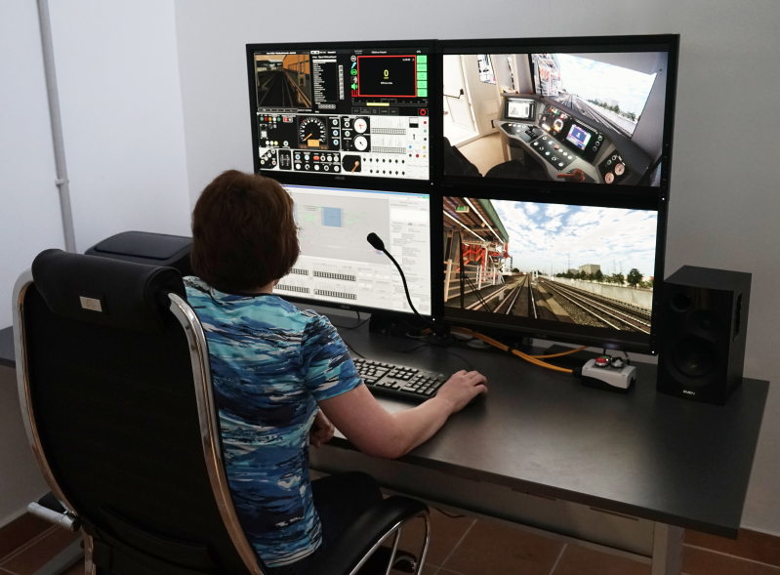
METRO ROLLING STOCK PRODUCTS
Metro simulators are designed for professional training and improvement of electric vehicle management skills composition, as well as to practice the actions of the driver in the event of malfunctions and emergency situations.

Slide 9
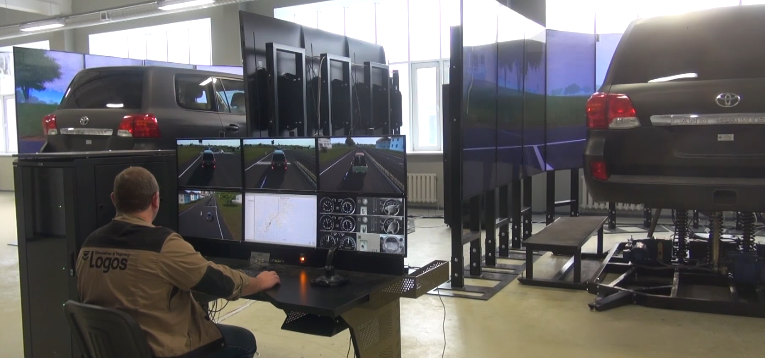

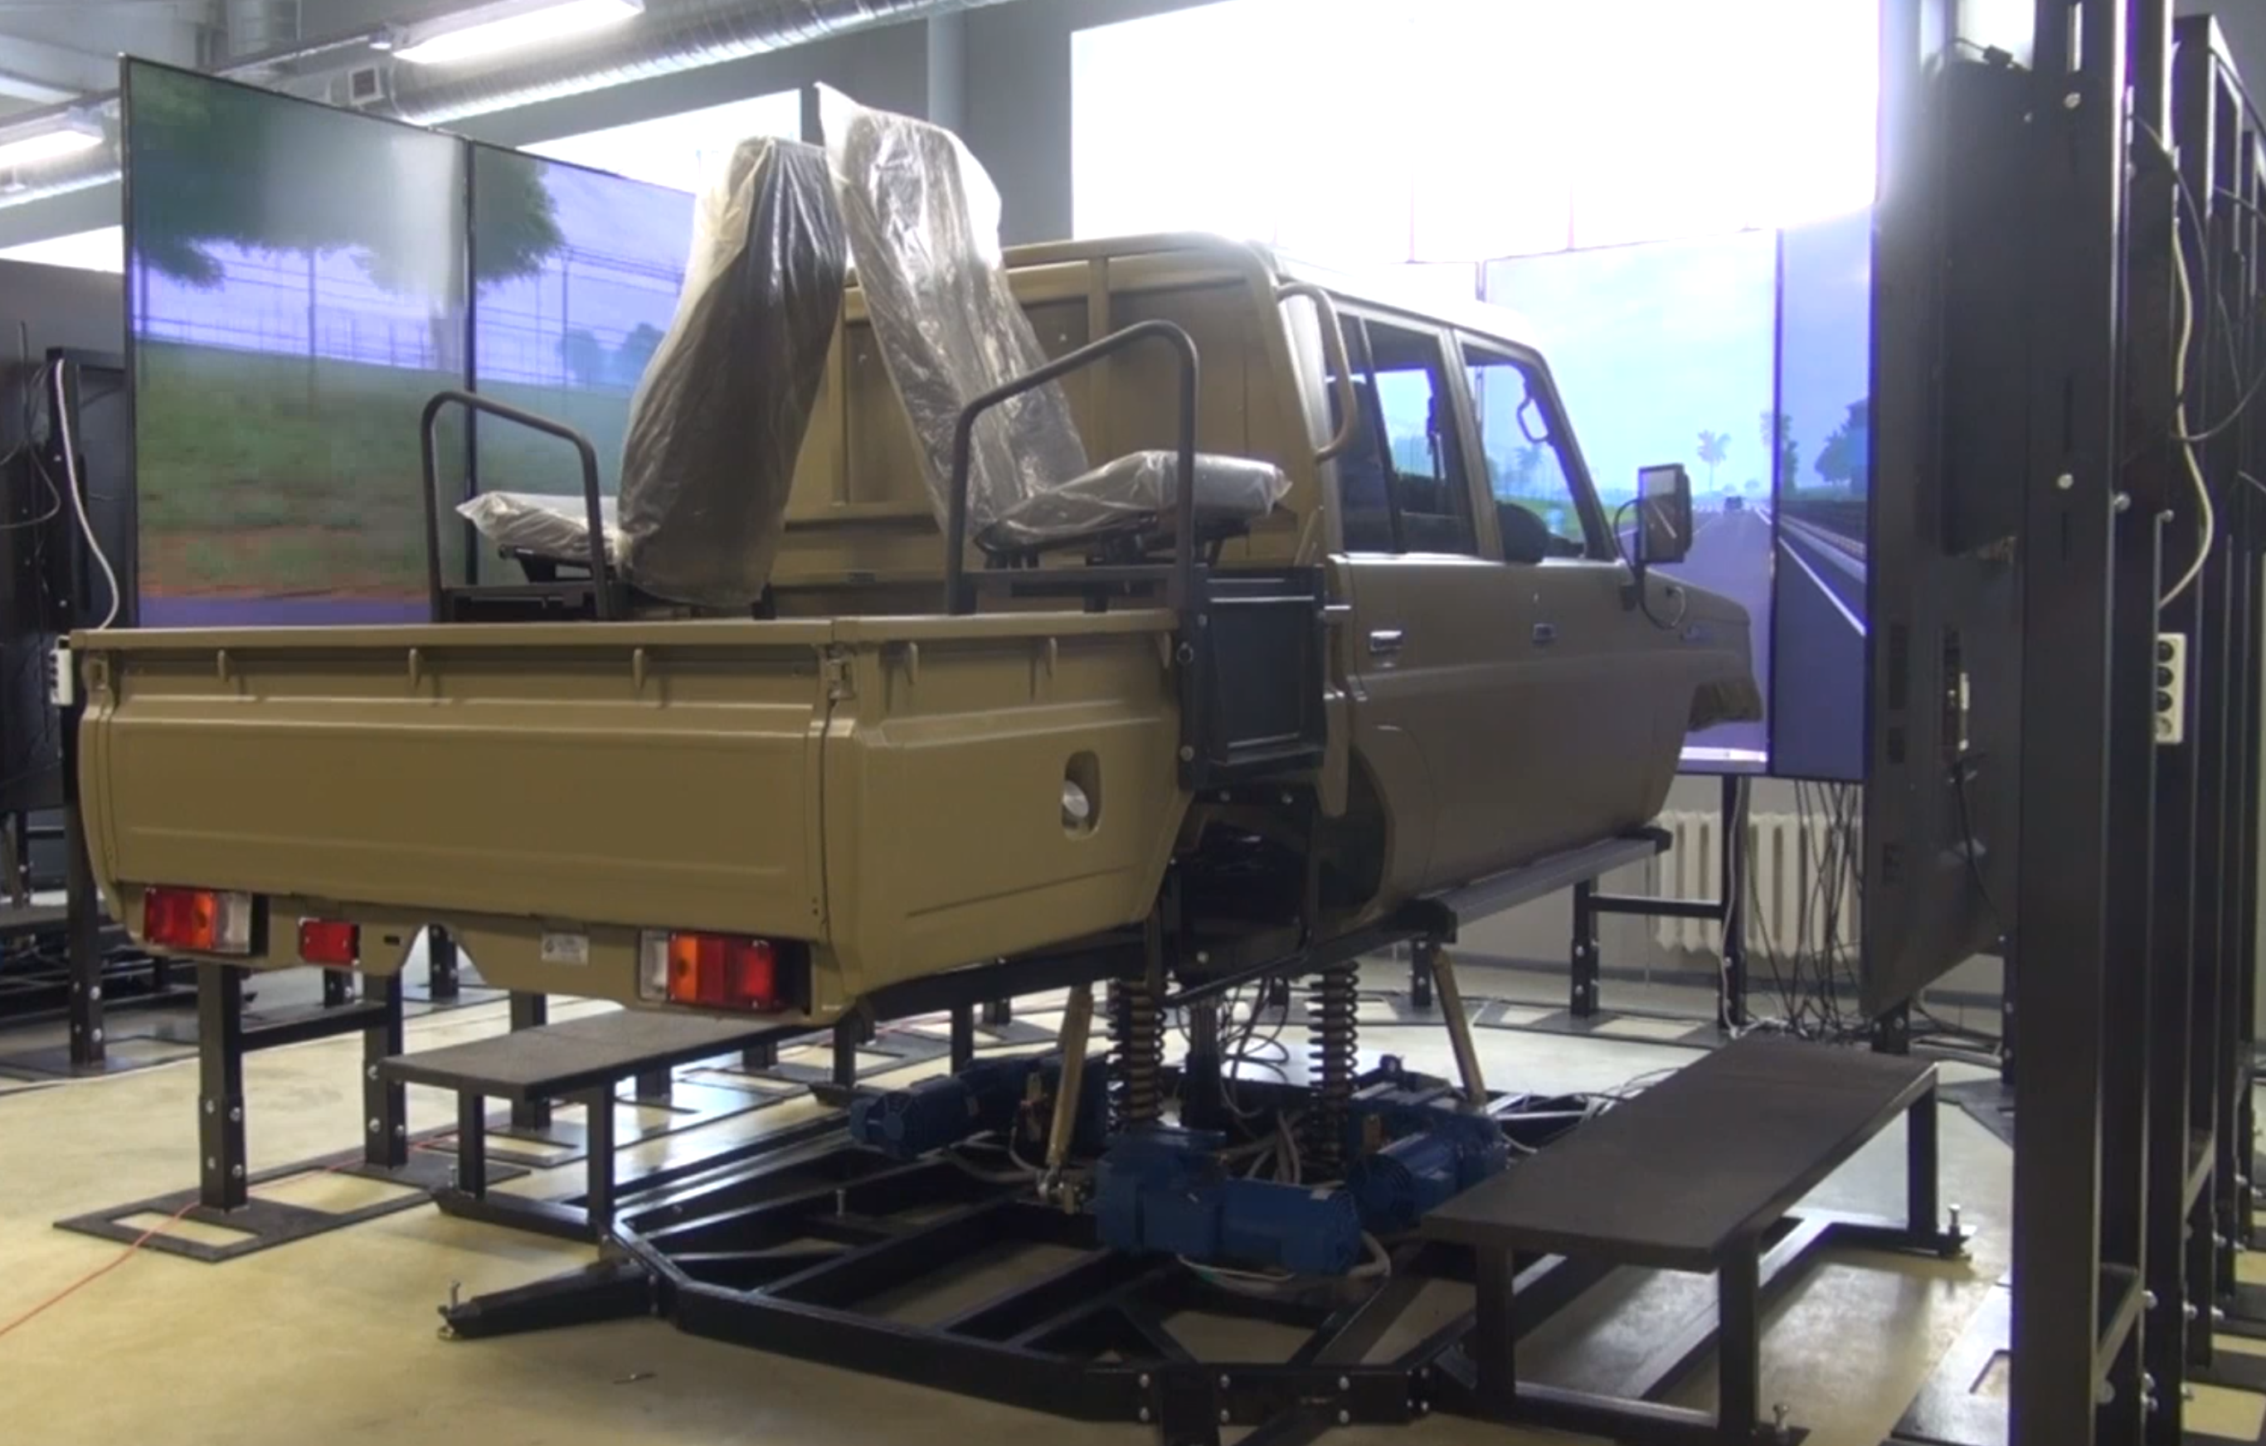
DUAL-PURPOSE PRODUCTS
Simulators for training crews of various special dual-purpose equipment based on wheeled and other type of chassis

Slide 10




OUR CLIENTS & PARTNERS
RUSSIAN FEDERATION
MINISTRY OF DEFENCE
MOSCOW METRO
COMPANY
MOSCOW PUBLIC TRANSPORT COMPANY
RUSSIAN FEDERATION
SECURITY SERVICE

Slide 11
PROJECT GEOGRAPHY
Russian Federation
Hungary
Azerbaijan
Angola
India
Uzbekistan
Algeria
Chile
Kazakhstan
South Korea
Turkmenistan
Armenia
Tajikistan
Uganda
South Africa
Yemen

Slide 12

CONTACTS
www.logos-sim.com
info@logos-sim.com
+7 495 995 52 18

