Slide 1

IBIK LLC
Tehran, Iran
May 6-8, 2024

Slide 2


ABOUT THE COMPANY
IBIK LLC was established in 2003 in Korolev city – rocket space center of Russia.
Our mission is to provide resource-saving technology, which makes shared use of computers possible. Sharing PC resources can help reduce the cost of IT infrastructure, save the environment and decrease the world’s digital divide.

Slide 3
OUR COMPANY
Our approach to solution realization is marked by innovation, combining immediate perceptiveness with a mechanistic, streamlined, and rapid startup process.
This approach is complemented by our team's high qualifications, which are on par with the leading entities in the IT industry.
We pride ourselves on our ability to quickly understand and address the unique needs of each project, ensuring both efficiency and excellence in our deliverables.
More than 20 years of experience in IT
Providing full technical support 24/7/365
More than 10 000 sells in 2023
Dealers in more than 100 countries around the world. There are also dealers in Iran.
OEM versions are produced for large customers in China, South Korea, Taiwan.
The largest markets are China, USA, India, Brazil.

Slide 4


COMPANY PRODUCTS
ASTER - Multiseat Software for MS Windows 11/10/8/7 and Linux
ASTER is a program (and only a program!) which allows to create a few workplaces on base of a single PC.
ASTER is a multiseat software for Windows 11/10/8/7 and Linux. ASTER does not use any thin clients and terminal stations. ASTER is being successfully used not only for equipping of computer classes, libraries, offices and Internet cafes, but even for games and video!
To create an additional workplace - you just connect 1 more monitor (you can connect to same video card), keyboard and a mouse to your computer (and if it is needed - microphone, speaker, joystick or gamepad).
Monitors may be connected by VGA/DVI/HDMI/DP cables. IT is also possible to use external monitors (preferably DisplayLink monitors) via USB or WIFI/LAN connections. After installing and launching, ASTER will provide each users with its own independent desktop.

Slide 5
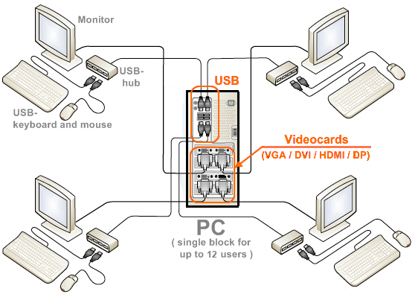
Simple Usage:
Just plug-in up to 12 monitors, keyboards
and mouses to 1 PC!

Slide 6
COMPANY PRODUCTS
Standard PCs
Multiuser PC workplaces
1000 USD / PC
265~600 USD / PC workplace
ASTER reduces total cost of ownership 2-3 times!

Slide 7
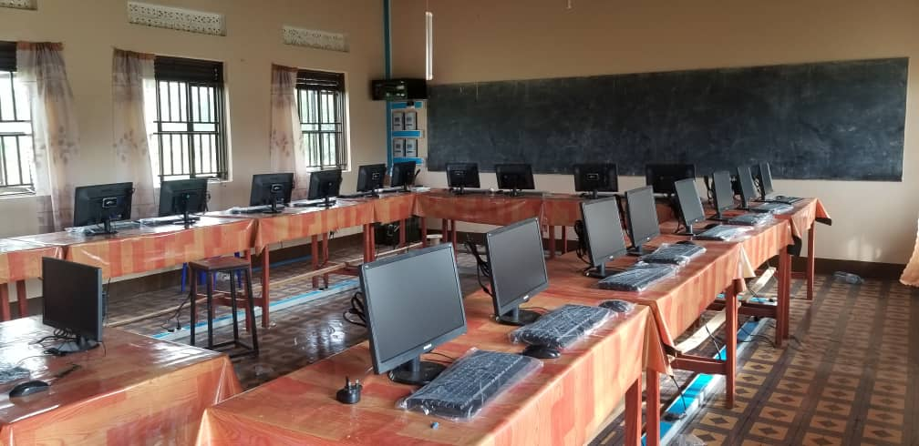
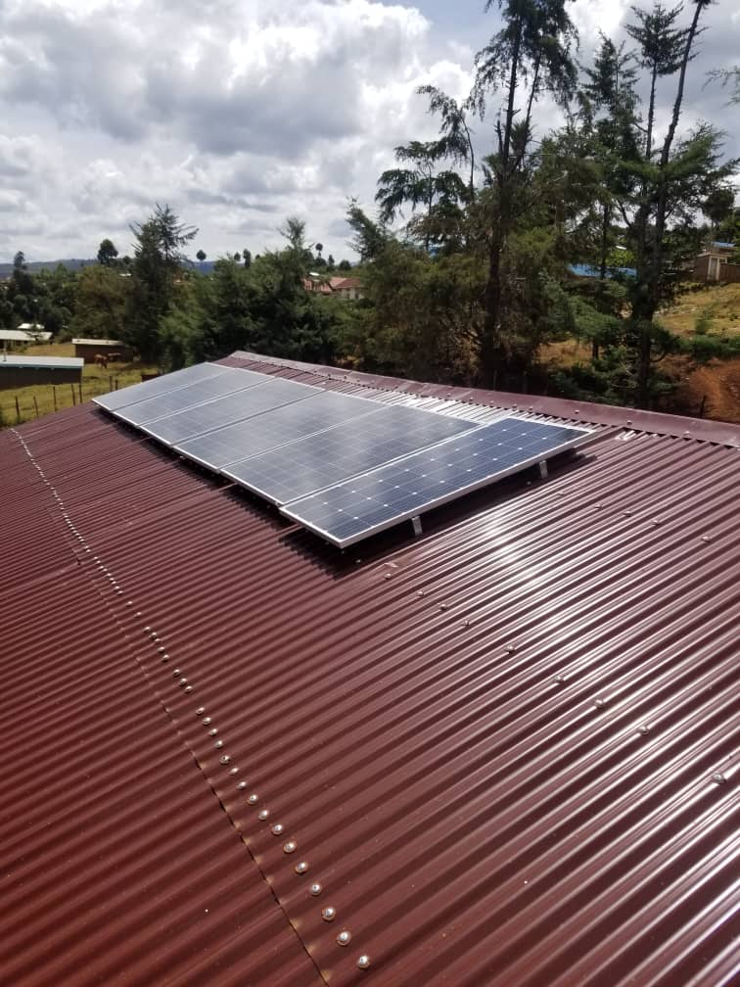
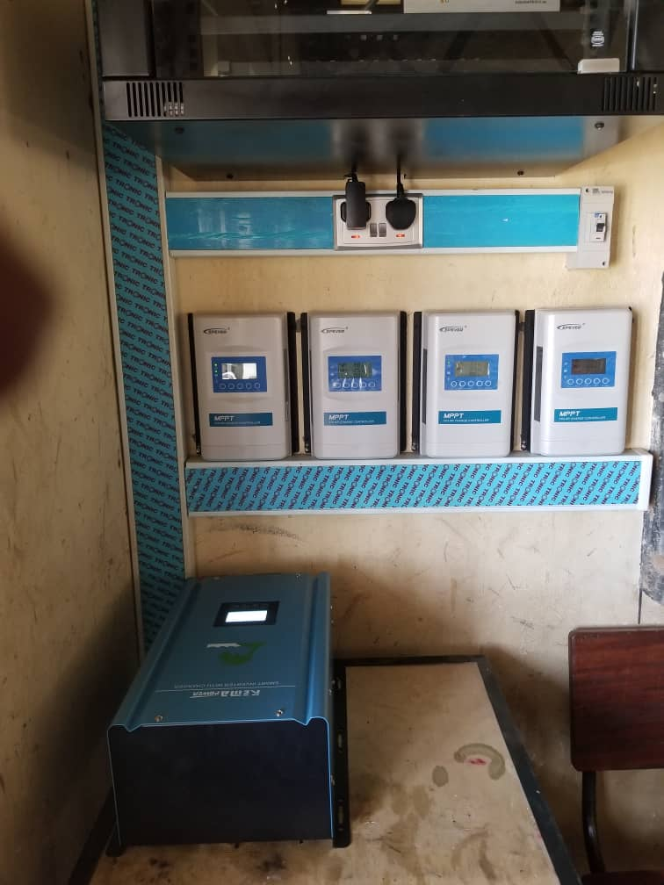
OUR PARTNERS
Computer Lab in Uganda
Solar Panels
ASTER helped to organise solar powered computer labs!

Slide 8
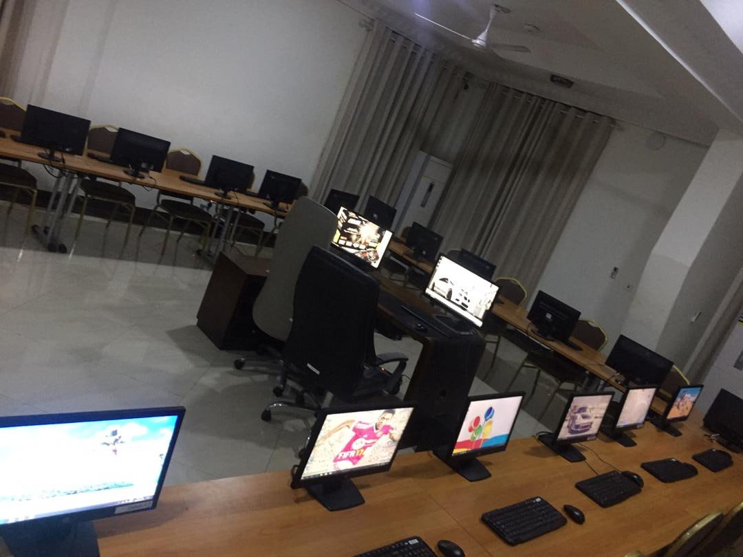
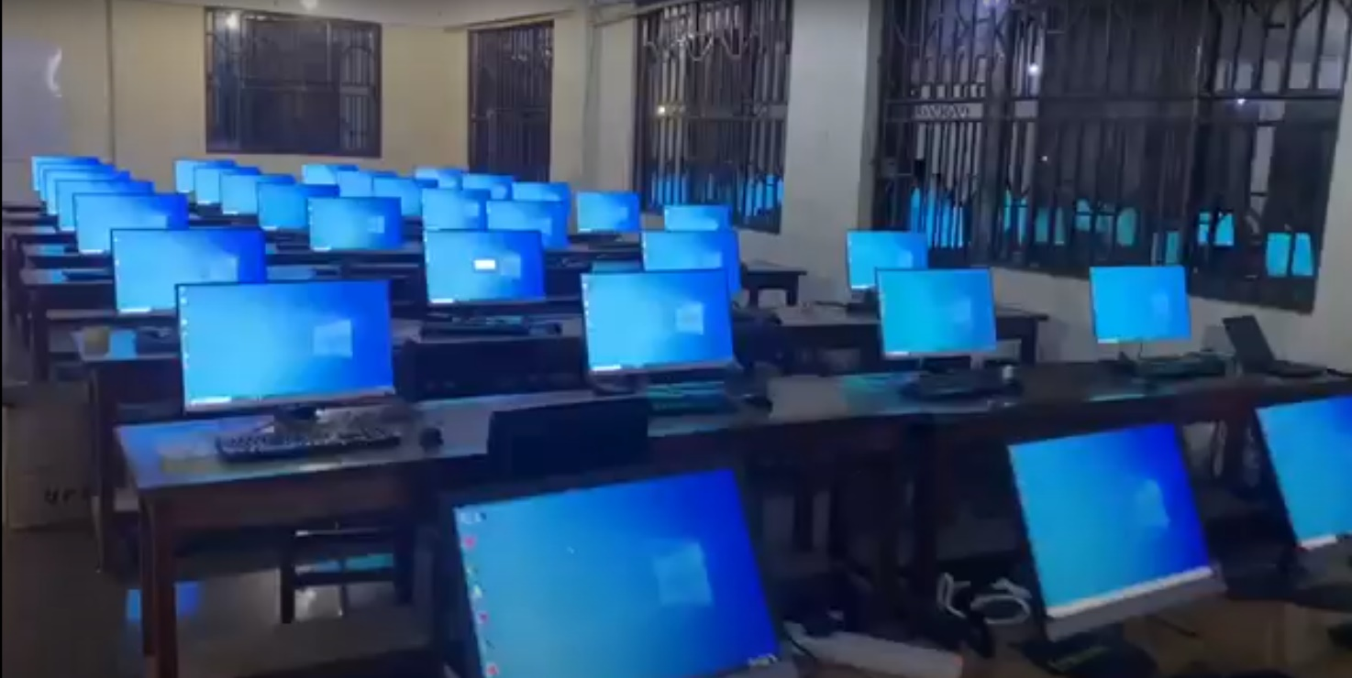
OUR PARTNERS
24 workplaces on 2 PCs
36 workplaces on 6 PCs
ASTER helped organizing big computer classes using few number of personal computers!

Slide 9
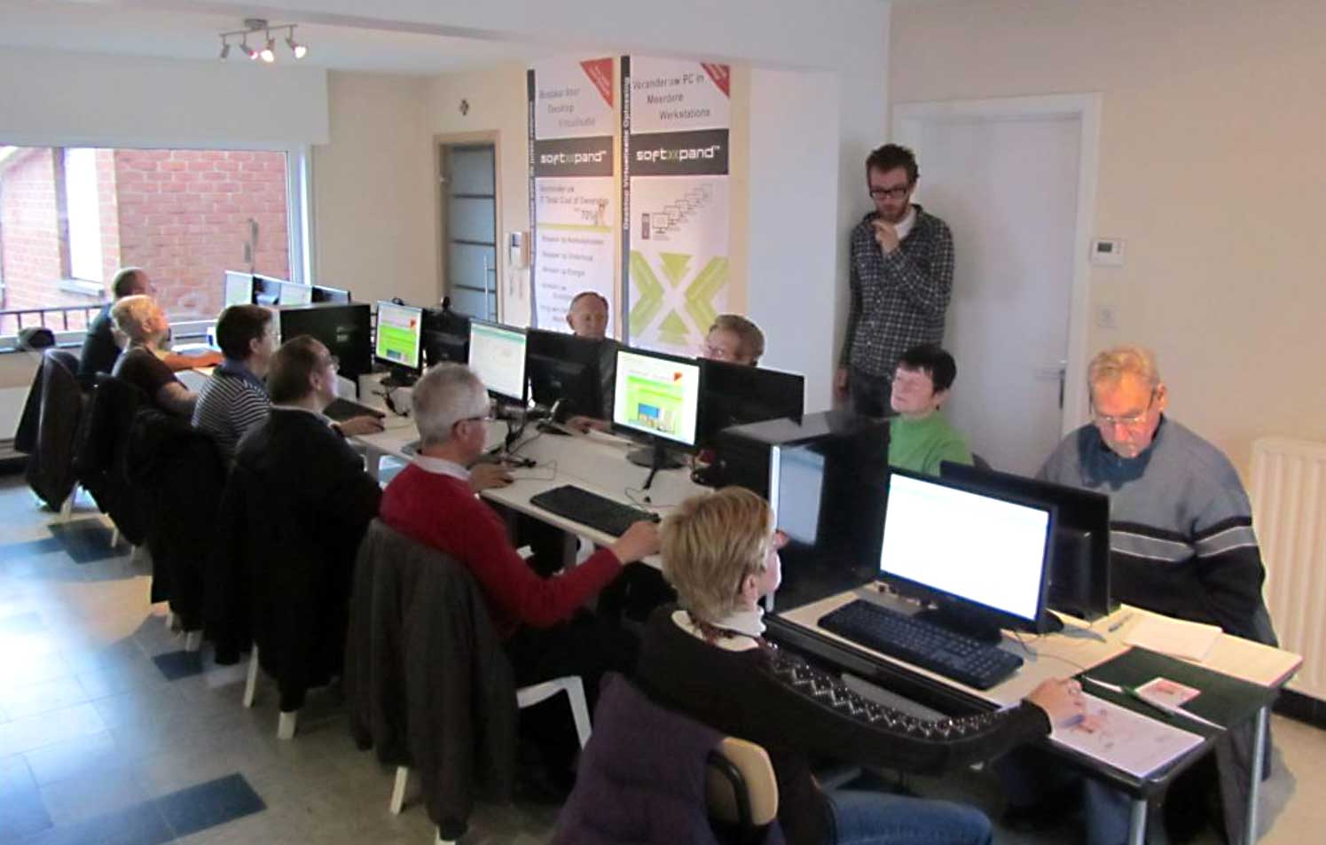
OUR PARTNERS
Belgium. Training Center. 6 seats on 1 PC

Slide 10
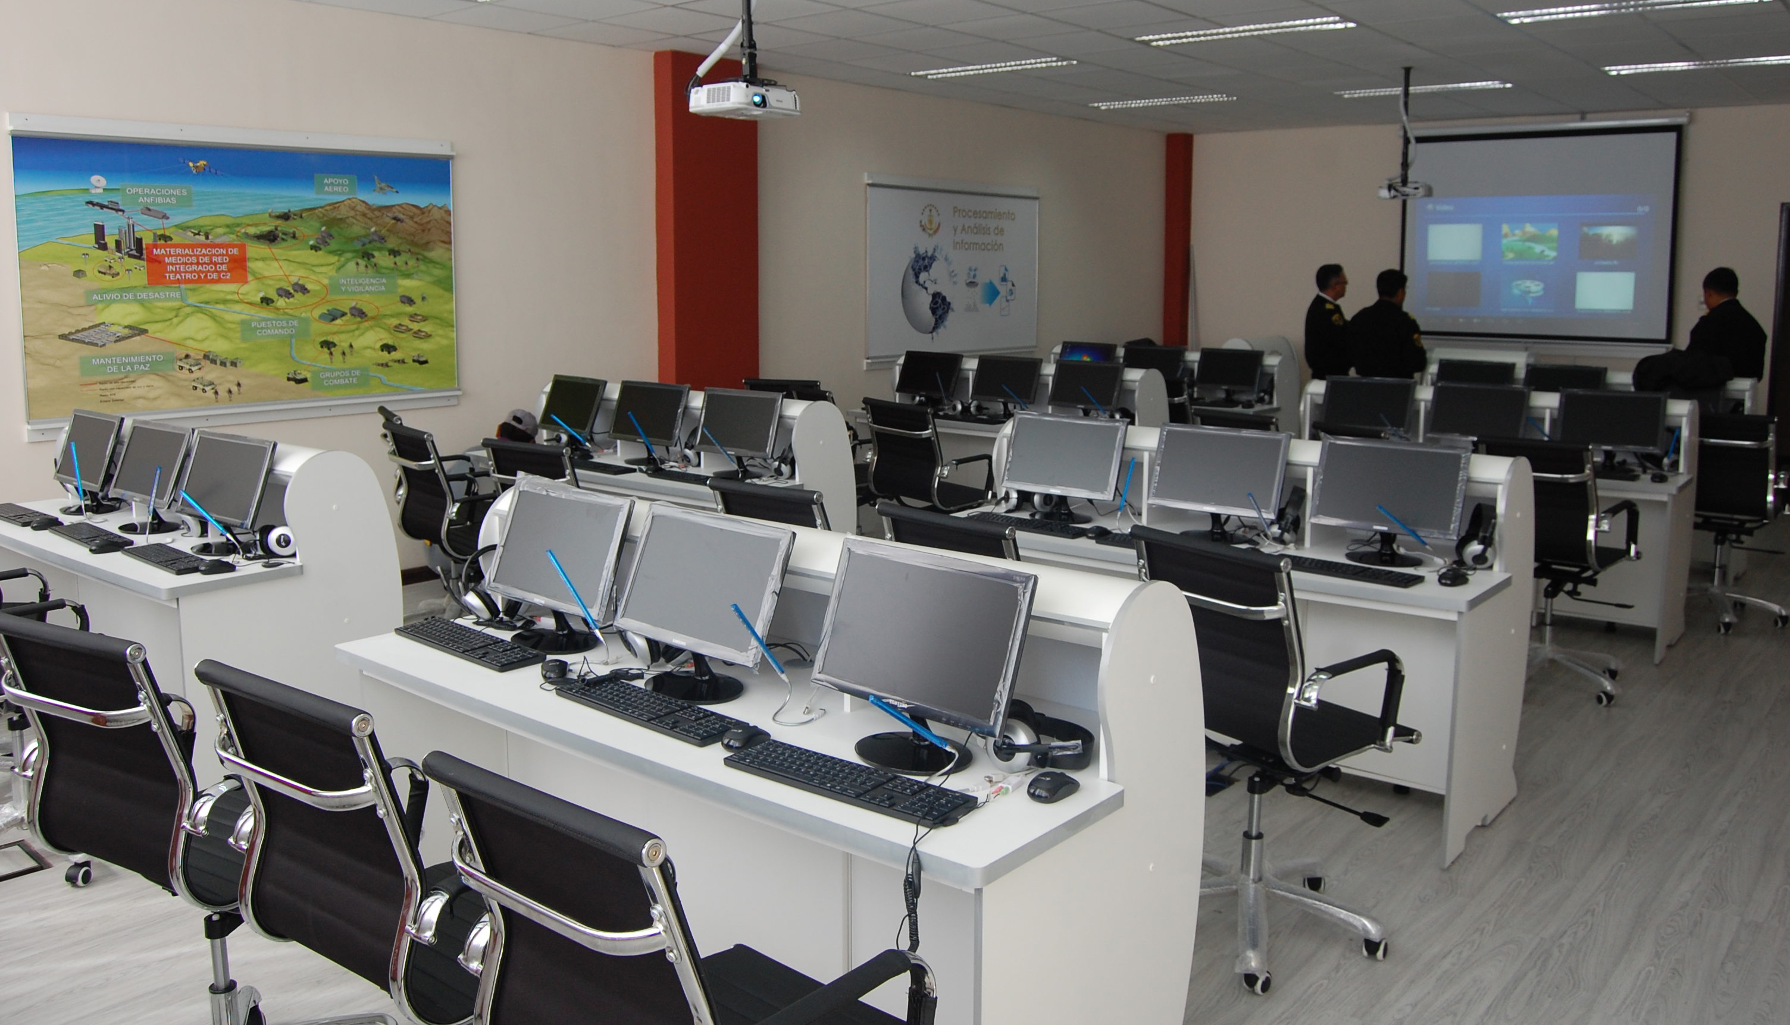
OUR PARTNERS
Bolivia. Training Center. 3 seats on 1 PC

Slide 11
OUR PARTNERS
South Korea. School. 12 seats on 1 PC

Slide 12
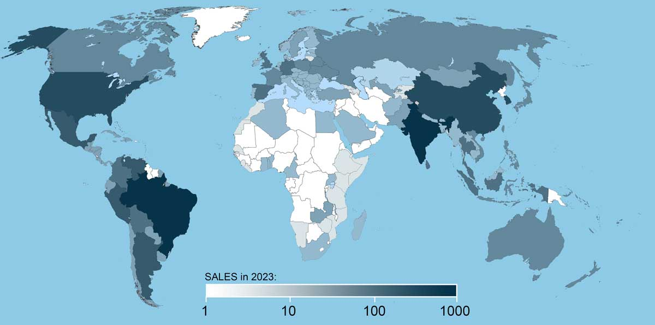
ASTER ONLINE SALES GEOGRAPHY
Largest markets:
China
USA
India
Brasil
South Korea

Slide 13

CONTACTS
www.ibik.ru
info@ibik.ru
+7 495 502 8201

