Slide 1



BIG DATA
MACHINE LEARNING
CONVERSATIONAL AI
by LLC DATALAB
www.datalab.automacon.ru

Slide 2



02
About Us
DataLab —
DataLab is a leading team of professionals in Big Data, Machine Learning, Conversational AI, NLP, Software Development, and AI.
We develop intelligent systems to streamline technological and business processes in retail and consumer sector.
60+
Data Scientists, AI Engineers, ML Specialists, AI Solutions Architects, NLP Engineers, etc.
LLC DATALAB

Slide 3



DataLab solutions for Business transformation
03
Data Management and Business Intelligence
Customer Experience improvement
AI
Conversational AI
Data Warehousing (DWH) construction
Customer Data Platform (CDP)
A/B testing platform
BI-platform
Predictive models
Recommendation system/ Personalization
Churn prediction models
Anti-fraud systems
Intelligent Chatbot (LLM + RAG)
Summarization
Content Classification

Slide 4
Recommendation system based on ML algorithms
04
3-5%
Recommendation system —
revenue increase
A set of Machine Learning (ML) algorithms for in-depth analysis of customer preferences in order to generate the most relevant personal offers.
10%
increase in basket margin
Business objective:
Increase revenue, customer satisfaction and retention through the utilization of customer behavior data to offer personalized recommendations.
~15-20%
increase in conversion to purchase

Slide 5

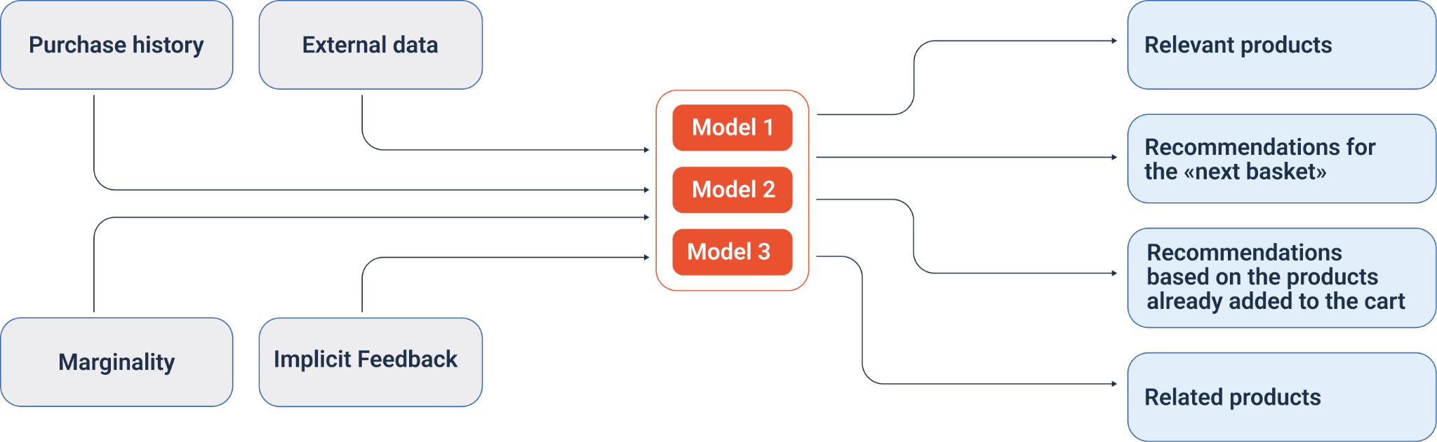
Recommendation System Architecture
05
An algorithm utilizing user data can anticipate their preferences, suggesting suitable products and assisting in discovering items or services that the user may have difficulty finding independently.
The recommendation system is based on several SOTA machine learning models optimized for the customer's tasks.

Slide 6
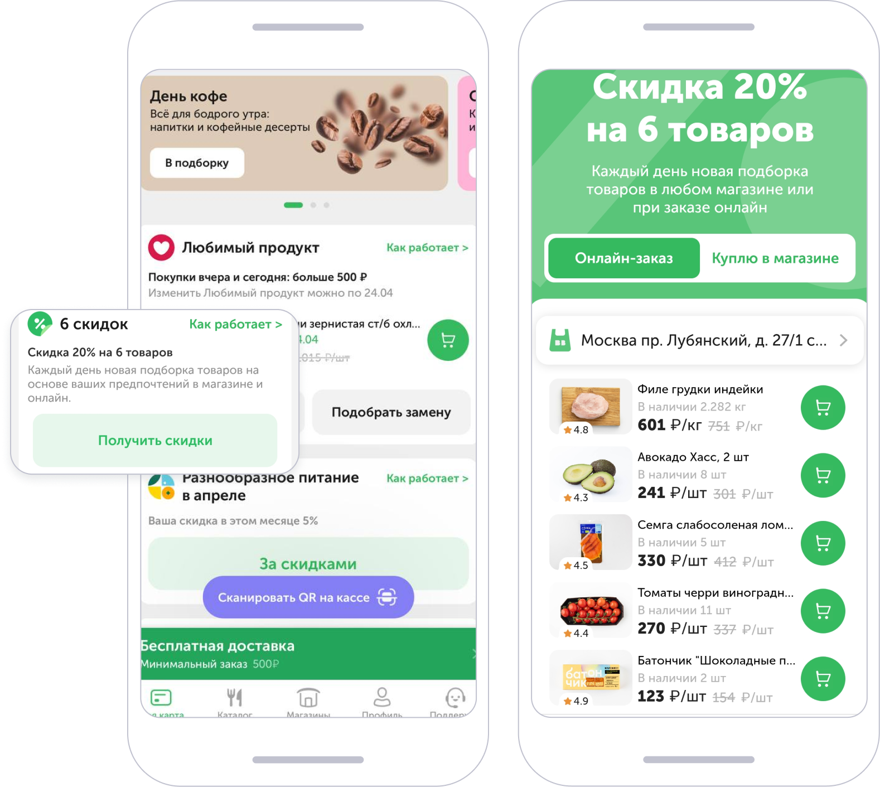
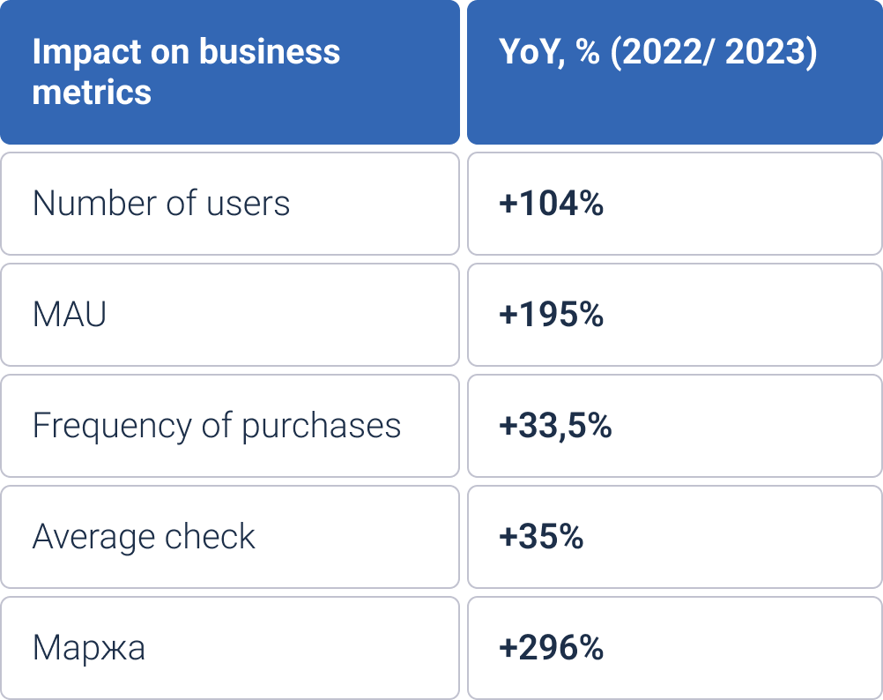
Case: Subscription for daily discounts
06
Retail network:
Share of online sales 47% (400K online transactions per day)
Number of TT 1500
* In 2022, the Subscription program was stopped and restarted based on ML recommendations

Slide 7
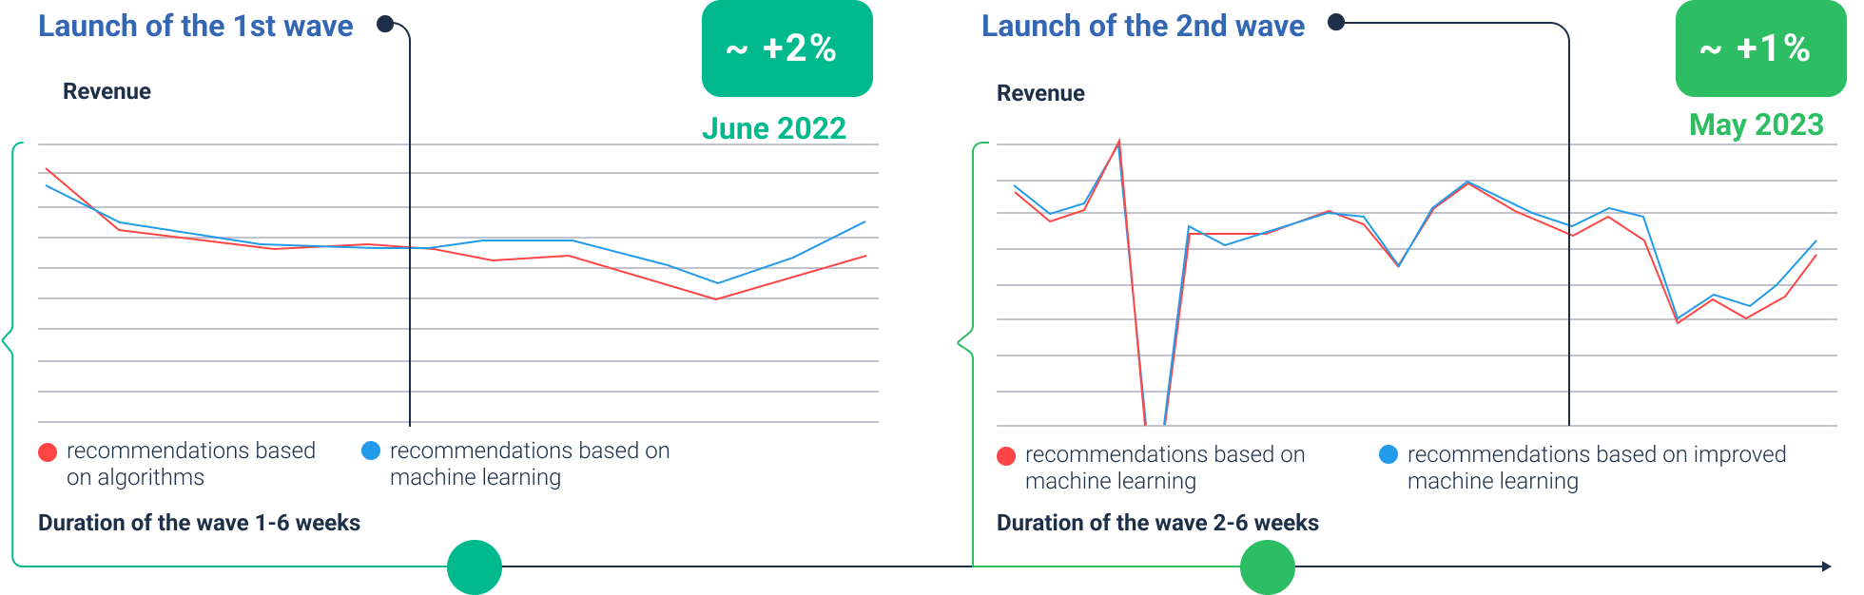
An example of effective AI implementation: Subscription for daily discounts
07
+3%
Impact on revenue
Selection based on algorithms
Wave 1
personal recommendations: +2% of revenue
Wave 2
3 models of individual recommendations:
new products;
products purchased earlier;
products not previously purchased;
+1% of revenue on top.

Slide 8

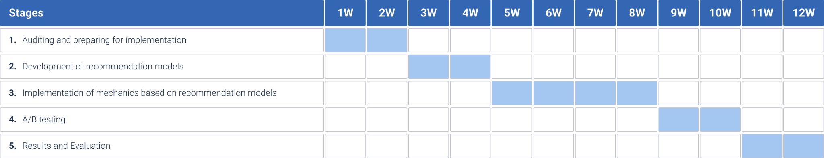
Roadmap for implementing Recommendation system
08
Options for system implementation:
On-premise;
SAAS

Slide 9

NLP-based Services
09

Slide 10
AI Chatbot (LLM-RAG)
17-13%
20%
80%
36%
10
AI Chatbot is a dialog system
The solution is based on the RAG architecture where a large language model (LLM) serves as a Contact Center specialist, providing answers to user queries based on data from an internal knowledge base.
sales increase
customer satisfaction growth
Incorporation into the company's operational workflows
1.
Contact Center
3.
Navigation through the interface
2.
FAQ on company documentation
4.
B2B
improving the efficiency of the service control department
Target Audience
Banks and insurance companies
Telecom Retail
Medical organizations
Delivery services
growth in the number of self-service connections

Slide 11
AI Architecture Components
11
Search
LLM (Large Language Models)
1.
Vector search is a specially trained model that converts data into vectors for subsequent processing in a vector database.
1.
A trained generation model that produces excellent quality on a case-by-case basis.
2.
Full-text algorithm effectively handles basic links and precise queries.
2.
SFT (Supervised Fine-Tuning) - additional training of the language subdomain generation model
3.
Vector database stores and processes vector data, housing an algorithm for comparing vectors to identify the most relevant candidates.
3.
DPO (Directed Preference Optimization) - additional training of the model, incorporating user feedback to enhance quality.
4.
MMR (Max Marginal Relevance) is a mechanism that makes search results more diverse and complete.
5.
Reranker is a specially trained model that ranks candidates, enabling the display of the most appropriate ones.
RAG (Retrieval Augmented Generation)
1.
Flexible RAG enables to download different knowledge bases and sources
6.
NER (Named-entity recognition) is a specially trained model that distinguishes search entities from large user queries.
2.
Branching based on a Customer Journey Map (CJM) for more precise answers
7.
Hybrid search is a pipe that combines all these components

Slide 12

AI Architecture Components
12
STT (speech to text)
TTS (text )
1.
A highly accurate speech recognition model trained on a large amount of data
1.
A modern speech synthesis model that delivers natural-sounding audio
2.
Compatible with multiple languages and dialects
2.
Compatible with multiple languages and dialects
3.
Integration with a range of audio data sources such as microphones, telephone lines, and audio recordings
3.
Customizable voice settings based on user preferences (with multiple options to choose from)
4.
Capability to operate in real-time for voice input applications

Slide 13


AI voice assistant (chatbot+SET+TTS)
13
AI voice assistant —
a voice-operated audio interface.
Business effect:
reducing the burden on the Contact Center
STT & TTS* —
a set of software solutions aimed at speech generation and recognition
>80%
of requests are processed automatically
* STT - speech to text - speech recognition
TTS - text to speech - speech synthesis

Slide 14

Classifier of customer inquiries
14
AI analysis of customer inquiries in the contact center —
Business effect:
automated analysis of customer inquiries in the contact center and chatbot for identifying user content, such as the purpose of the call (service request/correction, recommendations)
enhancing service quality
20%
customer satisfaction growth
Business Objective:
Marking customer inquiries for efficient handling by either an operator or an AI assistant and prompt replies

Slide 15

Corporate Data LakeHouse/ Data Warehouse (DWH)
15
Data Lakehouse/ Data Warehouse:
This repository encompasses all data gathered from diverse company information systems, utilized for generating reports, developing machine learning models, and for in-depth analysis of historical data.
Key advantages:
Business effect
1.
Saves time — quick search for insights, decision-making
5-year ROI
112%
2.
Improves data quality
Business objective:
Average payback period:
3.
Improves business intelligence
Business Intelligence systems — analysis and visualization in BI;
Data Mining — find hidden patterns and predict events;
Assistance for AI models.
1,6 years
4.
Ensures data consistency
5.
Increases Return on investment (ROI)
*According to International Data Corporation (IDC)
6.
Stores historical data
7.
Guarantees the security of personal data processing

Slide 16
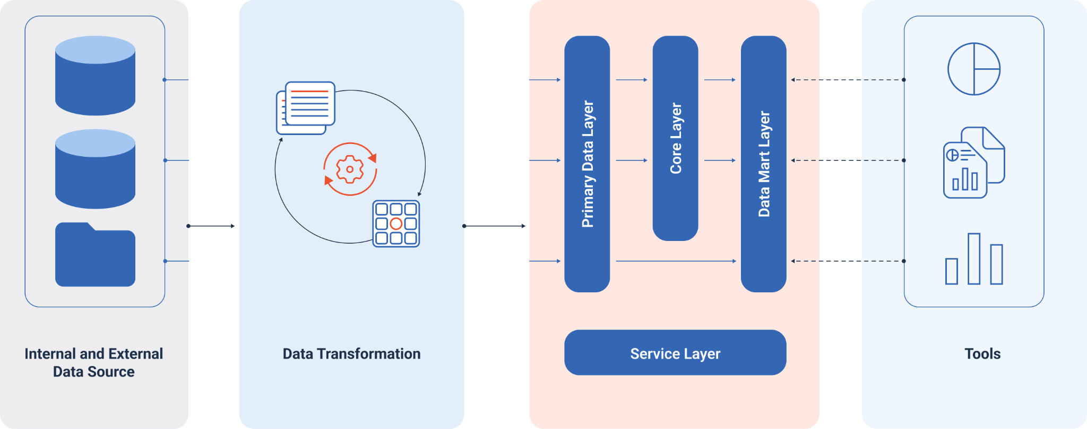
Data Lakehouse/ Data Warehouse Architecture Components
16
DATA SOURCE LAYER
STAGING
AREA
DATA WAREHOUSE
ANALYTICS AND BI

Slide 17
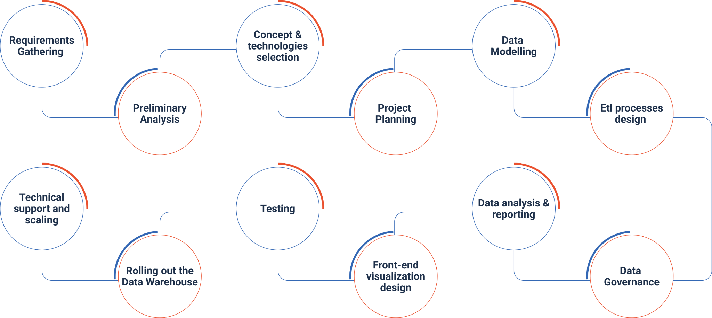
12 steps to design a Data Lakehouse/ Data Warehouse Solution
17

Slide 18





How can DataLab help with Data Lakehouse/ Data Warehouse Design
18
We are experienced and skilled at providing end-to-end Data Lakehouse/ Data Warehouse services:
Our team of dedicated data engineers, solution architects and more have sound working knowledge of using leading data warehousing tools like:
Conduct an audit and develop a roadmap for a competent implementation either from scratch or for enhancing performance, rectifying errors, and enhancing integration with visualization tools for the current storage system.
… and more
Design & Implement DWH from concept creation, methodology selection and architecture construction depending on business objectives - performance and reporting requirements.
Post-launch support
We have designed and built comprehensive data warehouse solutions, Operational Data Stores, and Data Marts for clients across industries.

Slide 19


















Technology stack
19

Slide 20

Work and grow with us!
SERGEY BUTENKO
DATALAB
Email: s.butenko@automacon.ru
t.me/SergeyButenko

