Slide 1

Darin, LLC
Tehran, Iran
May 6-8, 2024

Slide 2


ABOUT THE COMPANY
DARIN is a registered trademark of a domestic manufacturer of equipment for swimming pools. The company "Darin" LLC was founded in 2006 and is the oldest among the manufacturers of this equipment in Russia.

Slide 3
OUR COMPANY
Our company has a design department, a production base, which makes up a full cycle of our own production. The service department provides technical support during the installation and operation of equipment, carries out warranty and post-warranty repairs, the constant availability of spare parts and components - all this together allows us to confidently give a 2-year warranty for our products and serves as a guarantee of many years of operation of our equipment.
DARIN today is a friendly team of like-minded people with ambitious plans for further development.

Slide 4
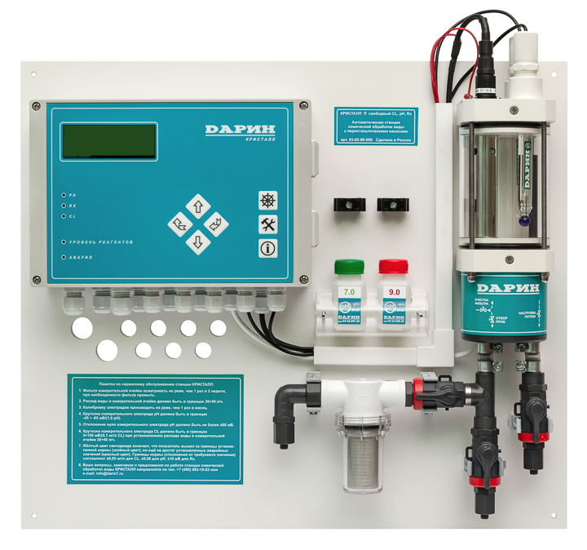
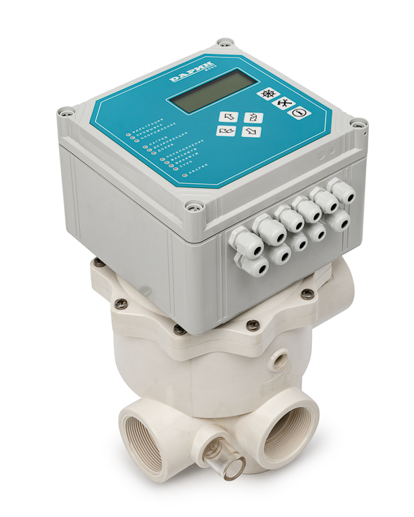
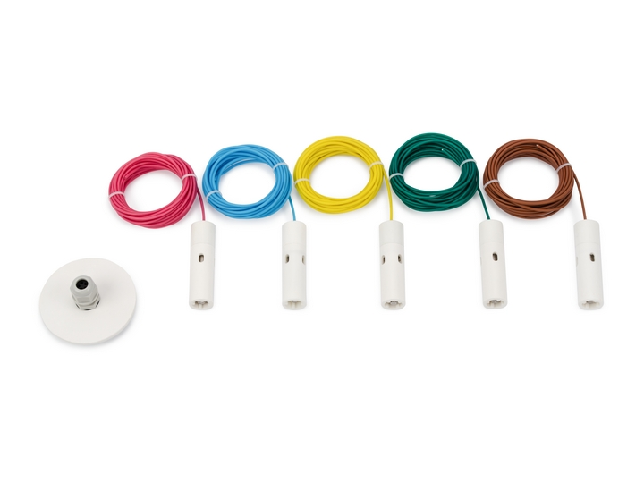
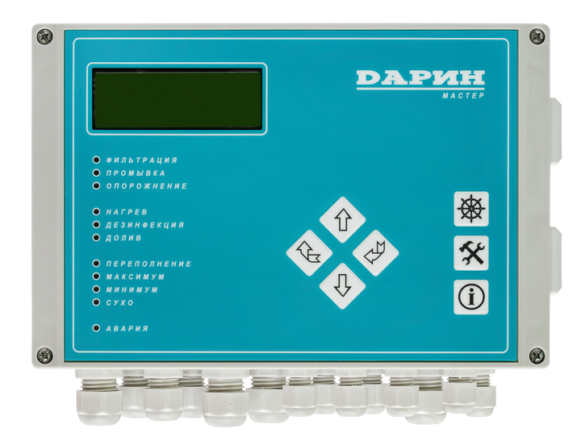
COMPANY PRODUCTS
Manufactures products for swimming pools, fountains with a 2-year warranty:
- automatic control and regulating stations to maintain water in preset parameters (free chlorine, pH, Redox) with membrane and peristaltic pumps;
- control devices for filtering, heating and water level in swimming pools;
- automatic filter backwash units for 6-way valves and 5-way valve groups with electric drive or pneumatic drive;
- level sensors for overflow tanks (conductometric, float).
- software for remote dispatching of an object from a smartphone, tablet, computer.

Slide 5




OUR PARTNERS

Slide 6




OUR CLIENTS

Slide 7
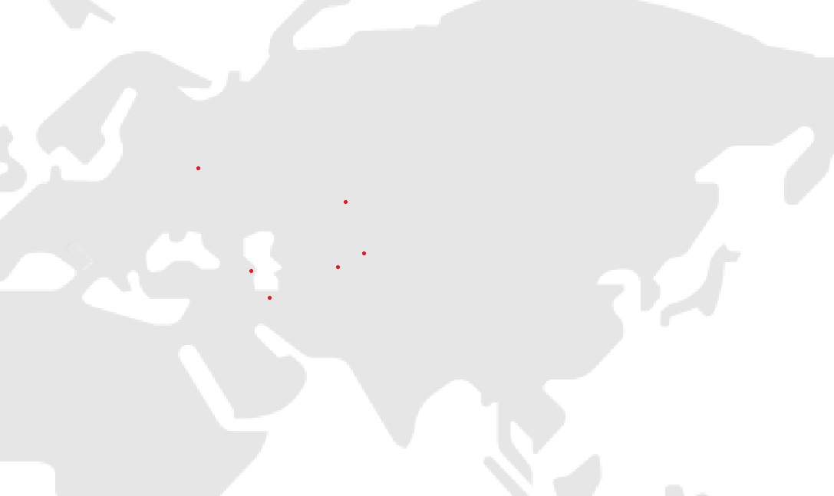
PROJECT GEOGRAPHY
Moscow
Astana
Bishkek
Baku
Tashkent
Tehran

Slide 8

CONTACTS
www.darin7.ru
info@darin7.ru
+7 495 983 10 83
+7 916 624 09 79

